Slide 1
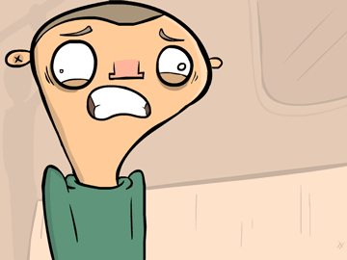
Acute Exacerbations of COPD
Shauna Sheridan
Clinical Specialist Physiotherapist
Royal Brompton
4th February 2025

Slide 2

Learning Outcomes
Demonstrate an understanding of a respiratory assessment
02
Recognise signs of respiratory distress
03
Identify the best location to treat an exacerbation
04
Be aware of management strategies for acute exacerbations of COPD
05
Define an exacerbation
01

Slide 3

COPD lecture knowledge check
Can you classify the following patient according to the GOLD classification of COPD?
FEV₁ = 34% predicted
1 exacerbation in the last year which did not require a hospital admission
mMRC scored 4
CAT score 15

Slide 4
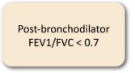

Answer
EXACERBATION
HISTORY
Spirometric Stage
≥ 2 moderate exacerbations or ≥1 leading to hospitalisation
E
Grade | FEV₁ (% predicted)
GOLD 1 | ≥ 80
GOLD 2 | 50-79
GOLD 3 | 30-49
GOLD 4 | < 30
0 or 1 moderate exacerbations (not leading to hospitalisation
A
B
SYMPTOMS

Slide 5
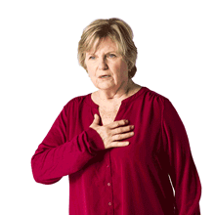
What is an exacerbation?
An exacerbation is a sustained worsening of the patient's symptoms from their usual stable state which is beyond normal day-to-day variations, and is acute in onset. Commonly reported symptoms are worsening breathlessness, cough, increased sputum production and change in sputum colour. The change in these symptoms often necessitates a change in medication.
(NICE, 2018)
Notes:
What is an exacerbation? A flare up of systems e.g. cough, increased SOB that worsens in < 14 days. Can be caused by a virus, bacteria or pollution thus it can be infective or non-infective. Can be mild, moderate or severe.

Slide 6

Scenario 1
You are working as part of an Admission Avoidance service and receive a call from a GP asking you to carry out a home visit to assess Mavis. Mavis is an 86 year old lady with COPD, heart failure and T1DM. She lives alone in a house with stairs. She is complaining of severe shortness of breath which has come on suddenly over the last 24 hours.
1) What other information would be useful to help determine a diagnosis and the severity of Mavis’ condition?

Slide 7
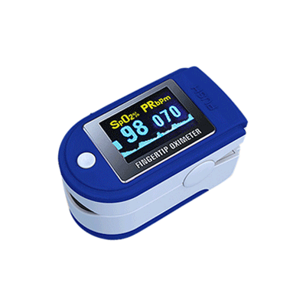
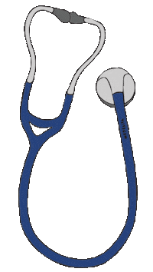
Answers
Question 1
Respiratory rate
Any signs of respiratory distress
Cough/sputum
? Swollen ankles
Oxygen saturations
Does Mavis have oxygen at home?
Chest auscultation
Is she coping at home?
What treatment has been initiated already?
Is she responding to treatment?

Slide 8
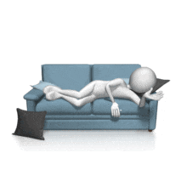
Following further questioning, you are informed that Mavis has resting oxygen saturations of 89% on her long term oxygen therapy prescription of 1LPM. Her respiratory rate is 32 and she has scattered coarse late inspiratory crackles on chest auscultation. Mavis is sleeping on the sofa downstairs.
2) What factors would you consider to determine whether it is safe to treat Mavis at home?
3) Where would you want Mavis to be treated?

Slide 9
Answers
 | Treat at Home | Treat in Hospital
Able to cope at home | Yes | No
Breathlessness | Mild | Severe
General Condition | Good | Poor/deteriorating
Level of activity | Good | Poor/confined to bed
Cyanosis | No | Yes
Worsening peripheral oedema | No | Yes
Level of consciousness | Normal | Impaired
Already receiving LTOT | No | Yes
Social circumstances | Good | Living alone/not coping
Acute confusion | No | Yes
Rapid rate of onset | No | Yes
Significant comorbidity | No | Yes
SaO₂ <90% | No | Yes
Changes on chest radiograph | No | Present
Arterial pH level | ≥ 7.35 | < 7.35
Arterial PaO₂ | ≥ 7kPa | < 7 kPa

Slide 10
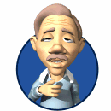
Scenario 2
Dennis is a 74 year old gentleman who has been brought to A&E by ambulance. He reported a 2 day history of progressive shortness of breath, wheeze and thick green sputum which he has been struggling to expectorate. He was found by the paramedics in respiratory distress with oxygen saturations of 82% on room air.
1) Can you give some examples of respiratory distress?
2) What investigations do you think Dennis needs?
3) What pharmacological treatment do you think Dennis requires?
4) What other treatment do you think would be useful?

Slide 11



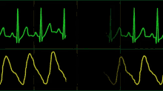
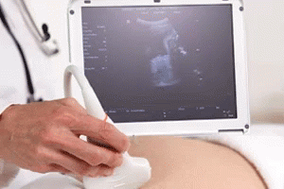
Answers
Question 2
Question 1
Pursed lip breathing
Prolonged expiration
Increased RR
Cyanosis
Active expiration
Fixing of upper limbs
Use and hypertrophy of accessory muscles
Soft tissue recession
Hoover’s sign
Notes:
Exclude co-morbidities: PE, HF – may need CTPA, US, D-dimer, Echocardiogram, BNP, Troponin– 5.9% were found to have a PE. Blood cultures
CRP
U+E

Slide 12
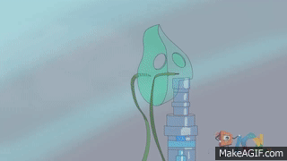
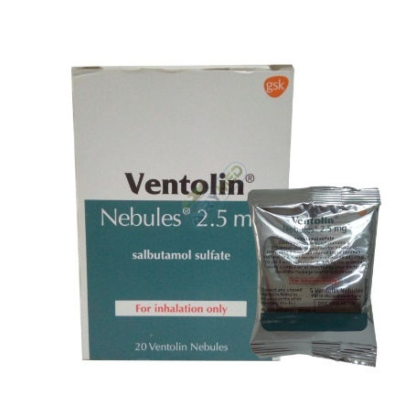
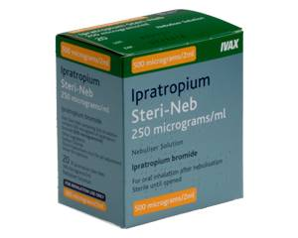
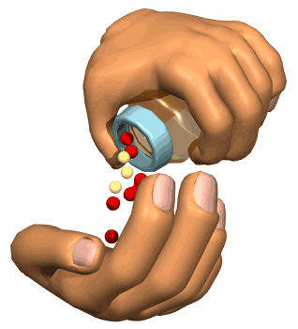
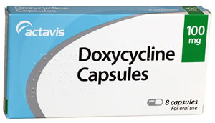
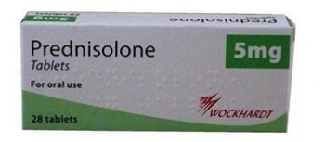
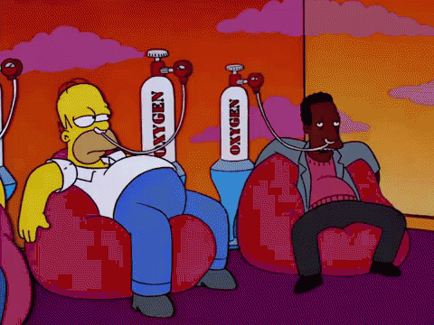
Answers
Question 3
Nebulisers
Antibiotics and steroids
Oxygen – target saturations 88-92%
O
Notes:
Goal of treatment: To minimise the impact of the current exacerbation and prevent the development of subsequent events
B2 agonists work directly on smooth muscle – sympathetic pathway
Anti-cholinergics block channels and prevent acetylcholine binding – parasympathetic pathways
No evidence in favour of nebulisers over MDIs but nebulisers tend to be easier for sicker patients
If a person with COPD is hypercapnic or acidotic the nebuliser should be driven by compressed air rather than oxygen
Antibiotics: Should be considered in the presence of increased volume of sputum and increased purulence + SOB. Shorten recovery time, reduce the risk of early relapse, treatment failure and hospitalisation duration – local bacterial resistance pattern
Steroids: Reduce inflammation, shorten recovery time, improve lung function, oxygenation, reduce risk of early relapse, treatment failure and the length of hospitalisation – note increased risk of pneumonia. Osteoporosis prophylaxis to be considered

Slide 13

Answers
Question 6
PHYSIOTHERAPY!!!!
Positive expiratory pressure devices
Positions of ease
Breathing techniques
Inhaler technique

Slide 14

Dennis’ arterial blood gases come back and his oxygen
levels are satisfactory on 4LPM via nasal cannula but his
carbon dioxide levels are very high. He is also becoming
increasingly confused.
5) What type of respiratory failure is Dennis in?
6) Do you think Dennis would benefit from any other treatment?
7) Which ward do you think would be most appropriate for Dennis?

Slide 15
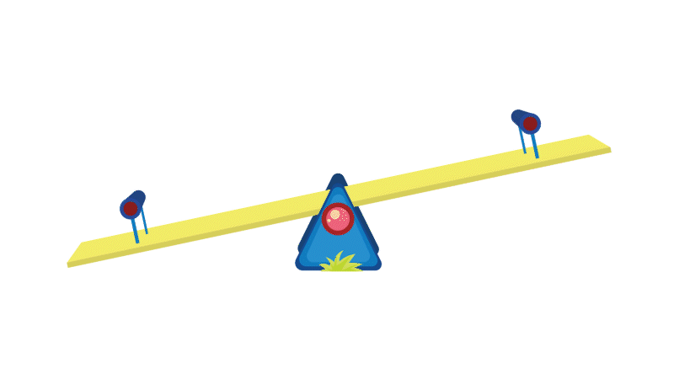
Answers
Question 5
Respiratory Failure Refresher

Slide 16
Type 1 Respiratory Failure
Decreased PaO₂
Normal or low PaCO₂
Treated with supplementary oxygen

Slide 17
Type 2 Respiratory Failure
Decreased PaO₂
Increased PaCO₂
Alveola hypoventilation
Can be acute or chronic

Slide 18
Acute Type 2 Respiratory Failure
Decreased PaO₂
Increased PaCO₂
Normal HCO₃⁻
Kidneys take 2-3 days to compensate for raised PaCO₂
Decreased pH – respiratory acidosis

Slide 19
Chronic Type 2 Respiratory Failure
Decreased PaO₂
Increased PaCO₂
Raised HCO₃⁻
Kidneys have now compensated
Normal pH
Example - COPD

Slide 20
Acute on Chronic Type 2 Respiratory Failure
Decreased PaO₂
Increased PaCO₂
Raised HCO₃⁻
Decreased pH – acidotic
PaCO₂ normally high but due to sudden deterioration has risen further so kidneys no longer able to compensate
E.g. acute exacerbation of COPD

Slide 21
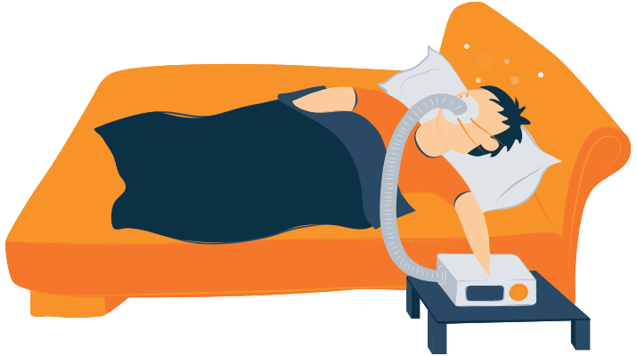
Answers
Question 7
Intensive Care Unit (ICU)
Question 6
Non Invasive Ventilation
Indications for Respiratory or Medical Intensive Care Unit Admission
Severe dyspnoea that responds inadequately to initial emergency therapy
Changes in mental status (confusion, lethargy, coma)
Persistent or worsening hypoxaemia (PaO₂ < 5.3 kPa) and/or severe/worsening respiratory acidosis (pH < 7.25) despite supplemental oxygen and non invasive ventilation
Need for invasive mechanical ventilation
Hemodynamic instability – need for a vasopressor
Notes:
NIV contraindications: Severe facial deformity, facial burns, upper airway obstruction, confusion, agitation, cognitive impairment, vomiting (how quickly can mask be removed?), large undrained pneumothorax, ? Copious secretions

Slide 22
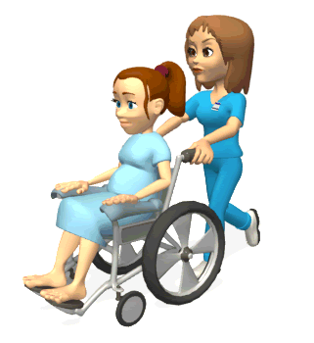
Scenario 3
Kathleen has been an inpatient for 3 days and has been treated for an infective exacerbation of COPD. She has now been deemed medically fit for discharge.
1) Is there anything in particular that you would like to do with Kathleen before she is discharged?

Slide 23


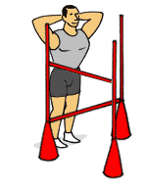


Answers
Smoking Cessation
Inhaler Technique
Rescue Pack
Self-management Plan
Pulmonary Rehabilitation
Follow-up

Slide 24
References and further reading
Overview: Chronic obstructive pulmonary disease in over 16s: Diagnosis and management: Guidance (2018) NICE. Available at: https://www.nice.org.uk/guidance/ng115 (Accessed: November 29, 2022).
2023 Gold Report - Global Initiative for Chronic Obstructive Lung Disease (2022) GOLD. Available at: https://goldcopd.org/2023-gold-report-2/# (Accessed: November 29, 2022)
Davidson A.C, Banham, S, Elliott, M, Kennedy, D, Gelder, C, Glossop, A, Church, A.C, Creagh-Brown, B, Dodd, J.W, Felton, T, Foëx, B, Mansfield, L, McDonnell, L, Parker, R, Patterson, C.M, Sovani, M, Thomas, (2016) BTS/ICS guideline for the ventilatory management of acute hypercapnic respiratory failure in adults, Thorax. U.S. National Library of Medicine. Available at: https://pubmed.ncbi.nlm.nih.gov/26976648/ (Accessed: December 11, 2022).

